Slide 1



A-Eye: See beyond limitations

Slide 2

Team Members
Abdelrahman Noaman
Abdelaziz Salah
Khaled Hesham
Kirollos Samy
Supervised By : Dr. Yousif Ghattas

Slide 3
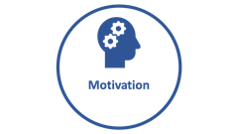

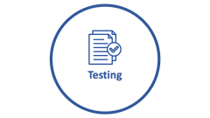
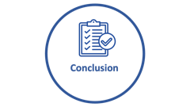


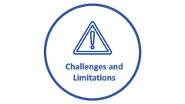

Agenda

Slide 4

Motivation

Slide 5

Motivation
“ Empowering the visually impaired people to seamlessly navigate, and perceive the world around them. ”

Slide 6

Motivation
Navigating the world around you is an essential endeavor

Slide 7
Motivation
Navigating the world around you is an essential endeavor
Obstacles pose potential harm to blind individuals, impeding their safe navigation in various environments.

Slide 8
Motivation
Navigating the world around you is an essential endeavor
Obstacles pose potential harm to blind individuals, impeding their safe navigation in various environments.
Understanding the environment surrounding is a big matter that hardens lives of blind people

Slide 9
Motivation
Navigating the world around you is an essential endeavor
Obstacles pose potential harm to blind individuals, impeding their safe navigation in various environments.
Understanding the environment surrounding is a big matter that hardens lives of blind people
Being blind can make individuals vulnerable to deception by others who may take advantage of their visual impairment.

Slide 10

Market and Literature Survey

Slide 11


Market Survey
providing advanced indoor positioning and navigation solutions.
integrated with iBeacons, leveraging this technology to enhance indoor positioning accuracy
It provides only navigation using a hardware devices
Cons: Expensive - needs pre-setup - limited to navigation
Notes:
https://duotone.shapefactory.co/?i=-HH3cGeAC4o&f=3fc7ff&t=2c0058&q=_
https://duotone.shapefactory.co/?f=3fc7ff&t=2c0058&q=_

Slide 12

Market Survey
provides a range of location-based services, including navigation, asset tracking, and analytics
integrated with iBeacons, and uses BLE and Wi-Fi signals to create unique fingerprints for different location
Cons: Expensive - needs pre-setup – limited to navigation only
Notes:
https://duotone.shapefactory.co/?i=-HH3cGeAC4o&f=3fc7ff&t=2c0058&q=_
https://duotone.shapefactory.co/?f=3fc7ff&t=2c0058&q=_

Slide 13
Market Survey
provides a range of location-based services, including navigation, asset tracking, and analytics
integrated with iBeacons, and uses BLE and Wi-Fi signals to create unique fingerprints for different location
Cons: Expensive - needs pre-setup – limited to navigation only
Notes:
https://duotone.shapefactory.co/?i=-HH3cGeAC4o&f=3fc7ff&t=2c0058&q=_
https://duotone.shapefactory.co/?f=3fc7ff&t=2c0058&q=_

Slide 14

Features

Slide 15
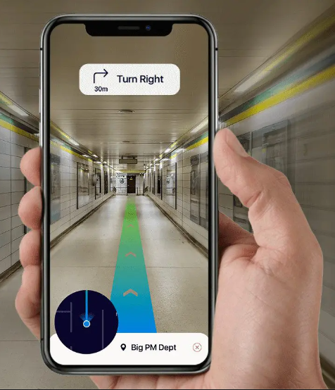
Features
indoor navigation system designed to empower individuals with visual impairments

Slide 16

Features
indoor navigation system designed to empower individuals with visual impairments
Obstacle Avoidance

Slide 17


Features
indoor navigation system designed to empower individuals with visual impairments
There are … … … in front of you!
Obstacle Avoidance
Scene Description

Slide 18

Features
indoor navigation system designed to empower individuals with visual impairments
Obstacle Avoidance
Scene Description
Reading Text

Slide 19
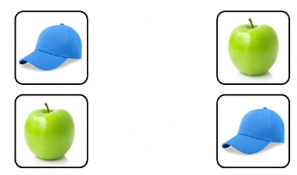
Features
indoor navigation system designed to empower individuals with visual impairments
Obstacle Avoidance
Scene Description
Reading Text
Object Matching

Slide 20
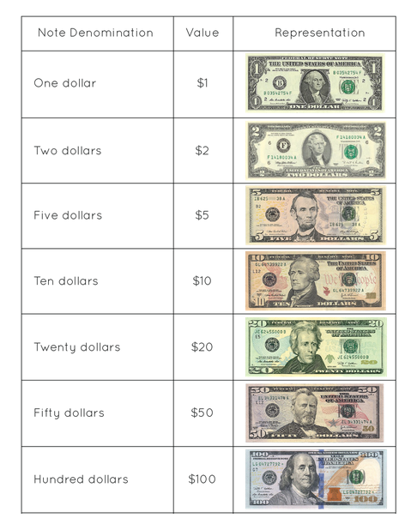
Features
indoor navigation system designed to empower individuals with visual impairments
Obstacle Avoidance
Scene Description
Reading Text
Object Matching
Identifying Currency

Slide 21

System Architecture

Slide 22
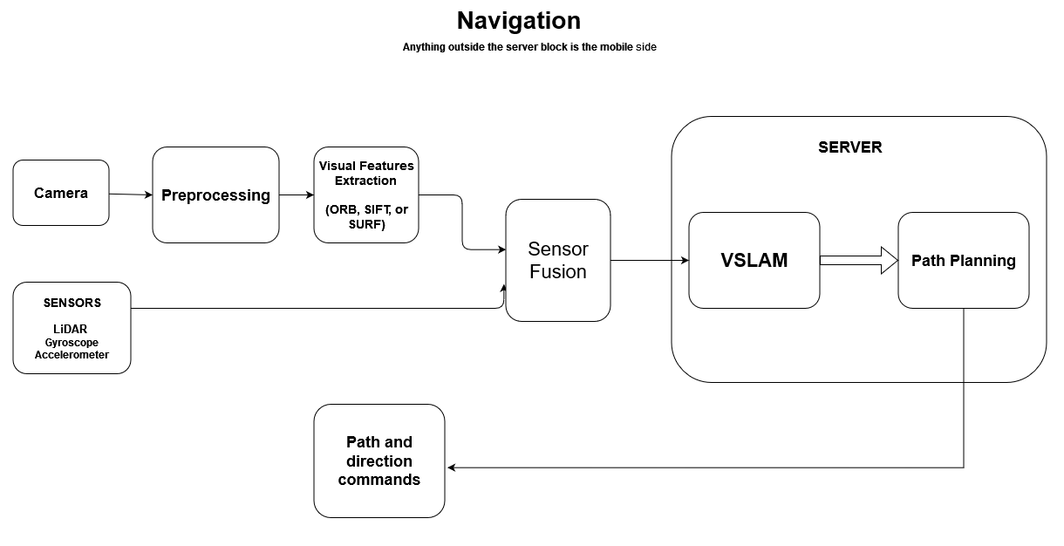
Navigation Architecture

Slide 23
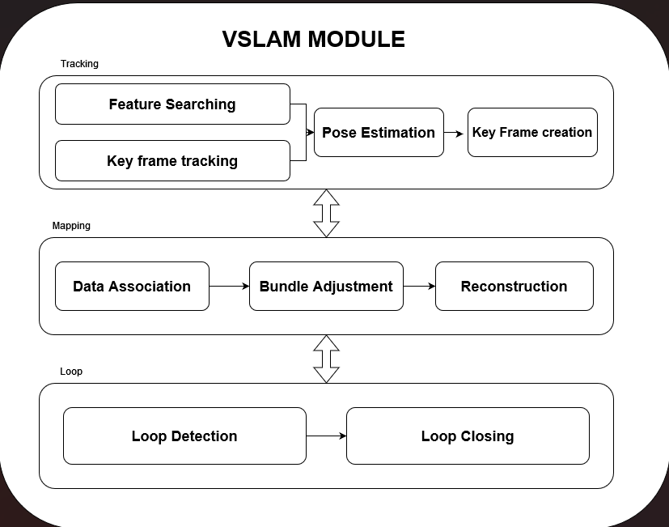
VSLAM Architecture

Slide 24
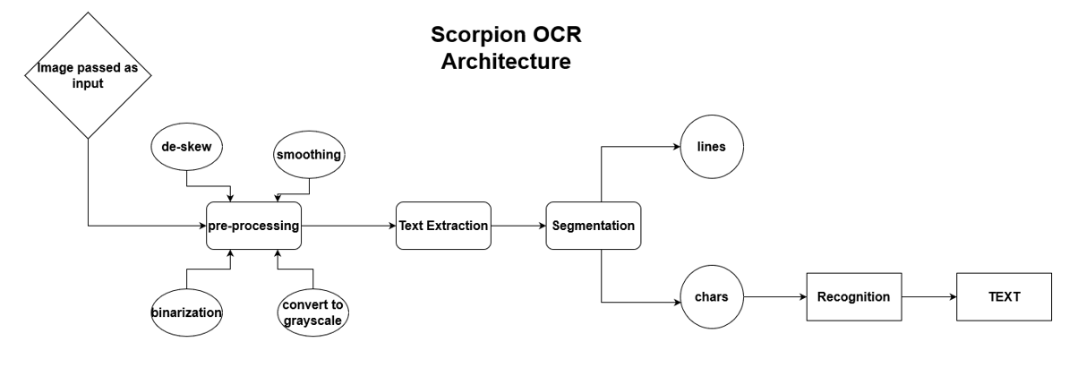
Scorpion Optical Character Recognition(OCR)

Slide 25
Scene Description Architecture

Slide 26

System Modules

Slide 27



VSLAM
Detect page shifting and remove its effect.
Reference image
New image

Slide 28

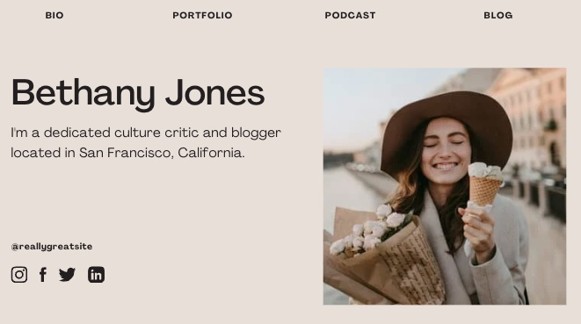

VSLAM
Detect page scaling and remove its effect.
Reference image
New image

Slide 29
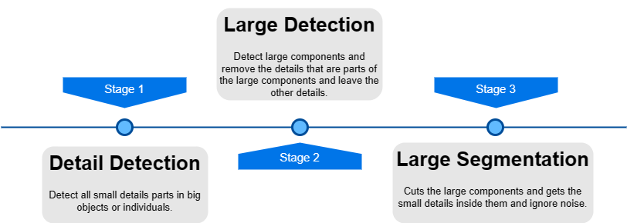
ORB (Oriented FAST and Rotated BRIEF)
Pipeline

Slide 30
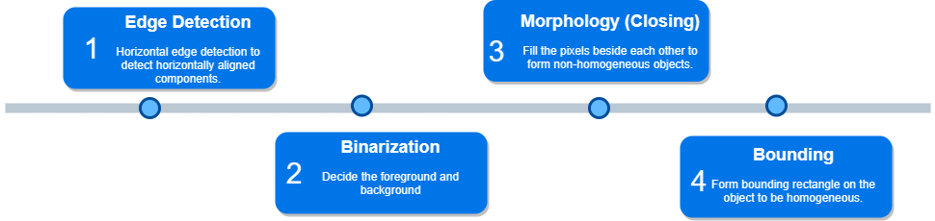
ORB (Oriented FAST and Rotated BRIEF)
Detail Detection

Slide 31
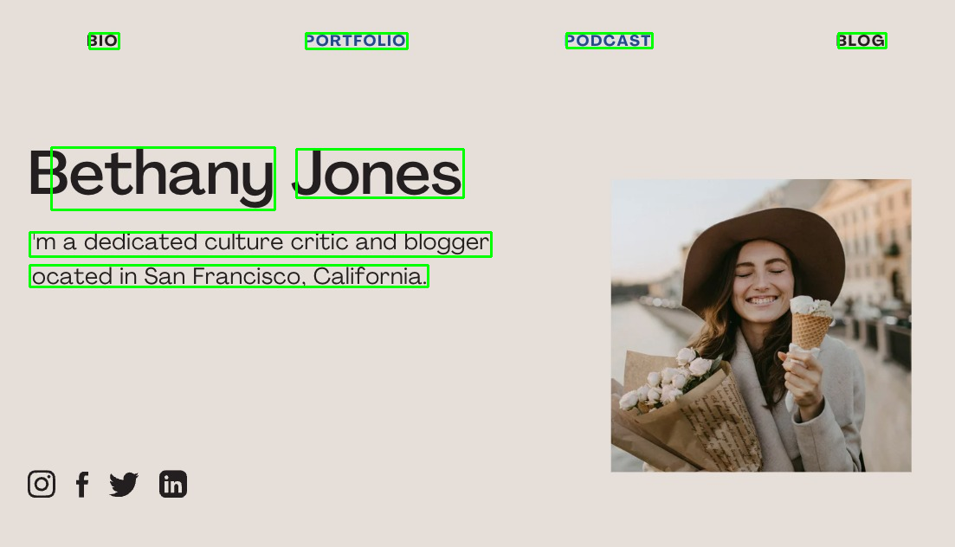
Scene Description
Detail Detection

Slide 32
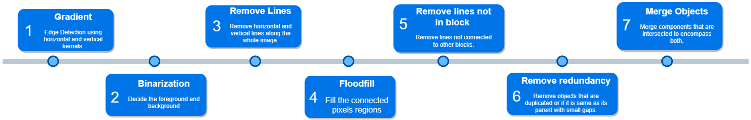
Scene Description
Large Detection

Slide 33
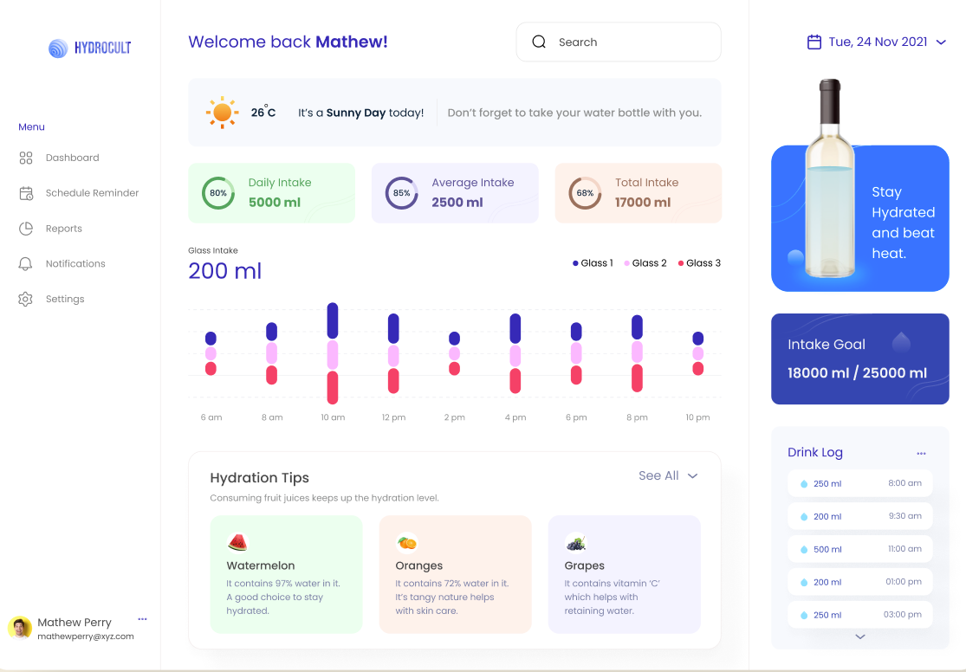
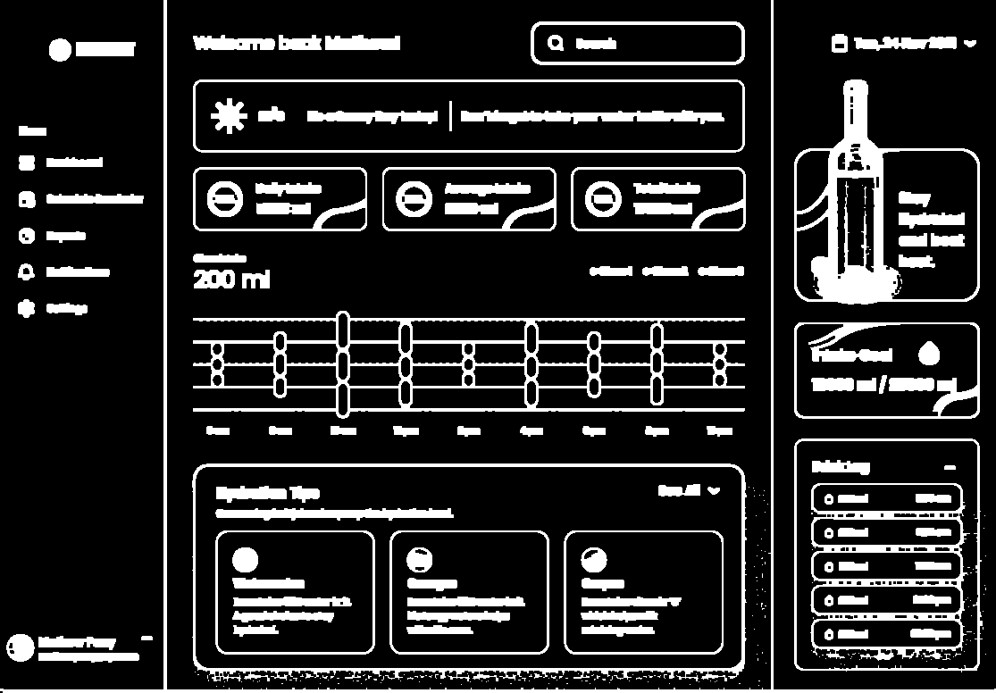
OCR
Gradient and binarization

Slide 34
OCR
Remove unwanted boundaries
Remove lines that are not part of the components but may disturb them.
Remove vertical and horizontal lines.
Remove lines that are taking the whole width/height.
Remove redundancy

Slide 35
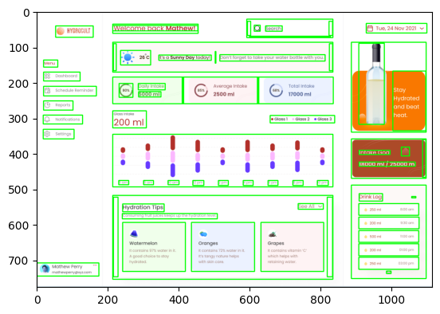
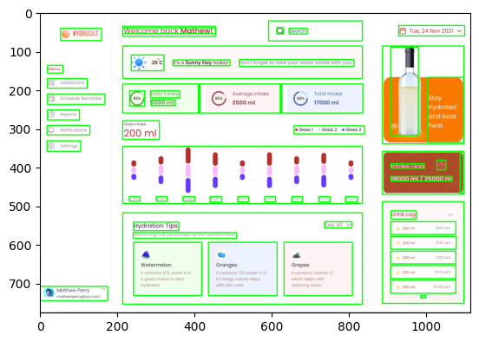
Object matching
Remove unwanted boundaries

Slide 36
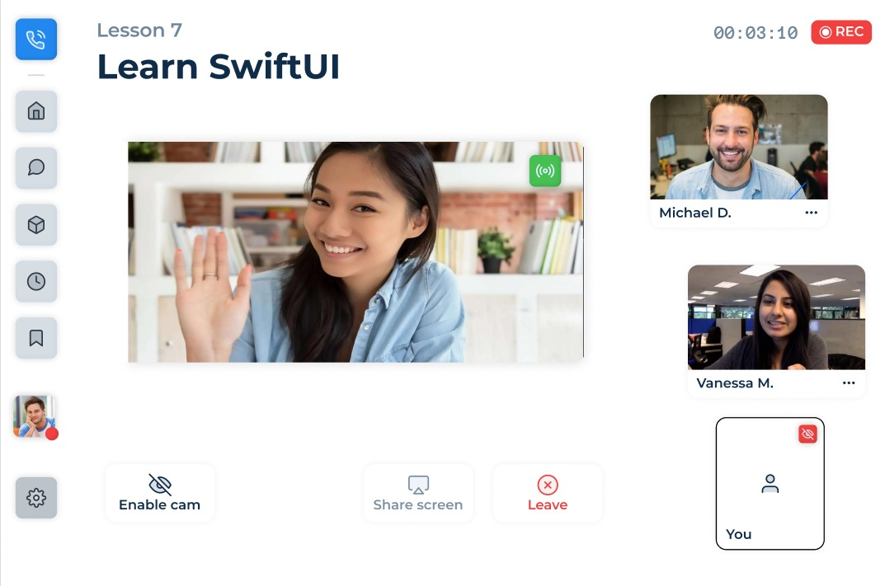
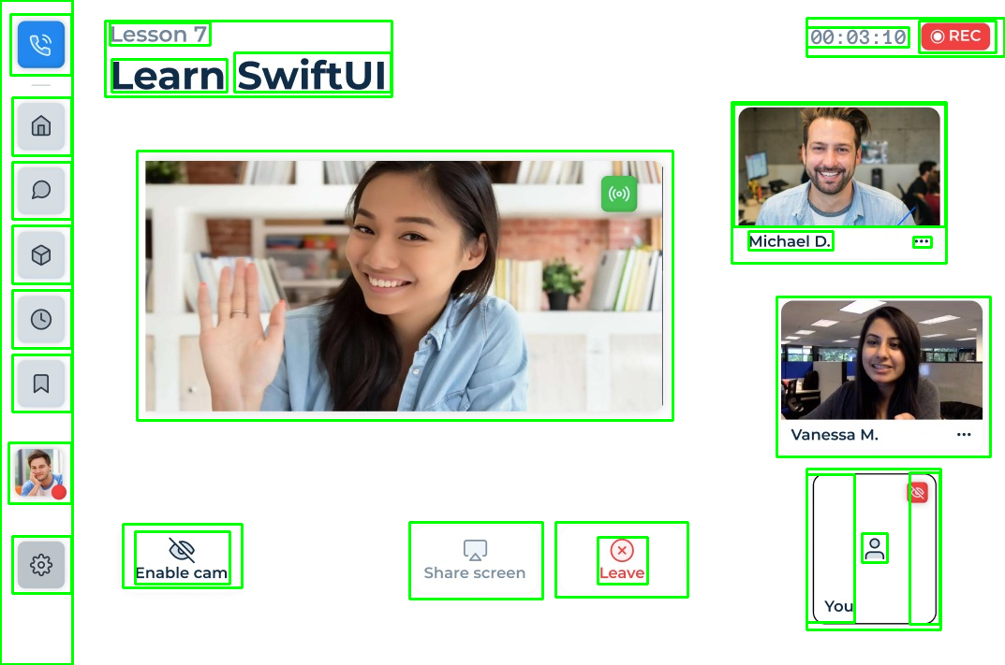
Object Matching
Other Examples

Slide 37

Challenges and
Limitations

Slide 38

Challenges
Object definition.
Object detection with high accuracy.
Object matching.
Changes classification.
Dataset creation.
Hyperparameter tuning.

Slide 39
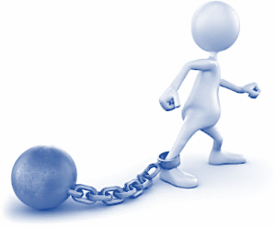
Limitations
Similarity measures don’t work well for low-resolution images.
Page scaling must not exceed 20% of the reference image size.
Hyperparameters may need to be changed for different domain-specific UIs.
To get the most out of the deep learning model we need a large labeled domain-specific dataset.

Slide 40

Conclusion

Slide 41
Conclusion
Our tool solves the common problems in the existing GUI testing tools.
Operate on the object level instead of the pixel level
Provide a strong tool for testing the GUI of desktop applications.
Allow some changes to be tolerated or ignored.

Slide 42

Future Work

Slide 43

Future Work
Improve object matching for low-resolution Images.
Produce more accurate bounding boxes in the dataset creation phase.
Use a machine learning model to classify the OS-dependent changes in small EDA icons.
Performance optimization to decrease runtime.
Add more integrations.

Slide 44
Project Modules
Module | Abdelrahman Noaman | Abdelaziz Salah | Khaled Hesham | Kirollos Samy | Ready-made %
VSLAM
ORB
Object Matching
Scene Description
OCR
Mobile Application

